Slide 1


Exploring identity online
5-7 years Resource presentation

Slide 2

MY PROFILE
YOUR PHOTO HERE

Slide 3










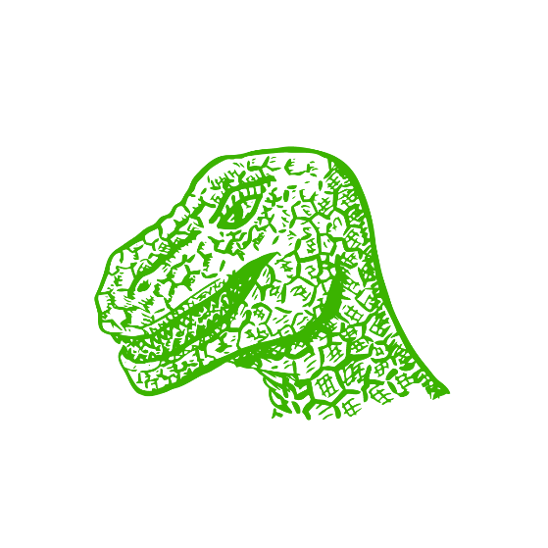




MY PROFILE
YOUR PHOTO HERE

Slide 4
MY PROFILE
YOUR PHOTO HERE

Slide 5








LIKES:
DISLIKES:
FAMILY FARMYARD
USERNAME:
FAVOURITE EMOJI:

Slide 6
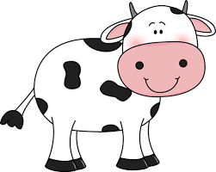

YOUR CHOSEN CHARACTER
LIKES:
DISLIKES:
Games
Grass
Sleep
Cuddles
Sunshine
Rain
Cheese
The dark
Feeling grumpy
Loud noises
FAMILY FARMYARD
USERNAME:
FAVOURITE EMOJI:
Cool.cow

Slide 7
Positive affirmation ideas…
We can…
We are…
We are…
We are…
We can…
We can…

Slide 8


